Slide 1

Reflections on (your) PowerCLI (and PowerShell) coding
Mittwoch, 23. März 2022
Luc Dekens

Slide 2
Agenda
Improving (some) code
The API(s)
Sharing in mind
Q & A

Slide 3
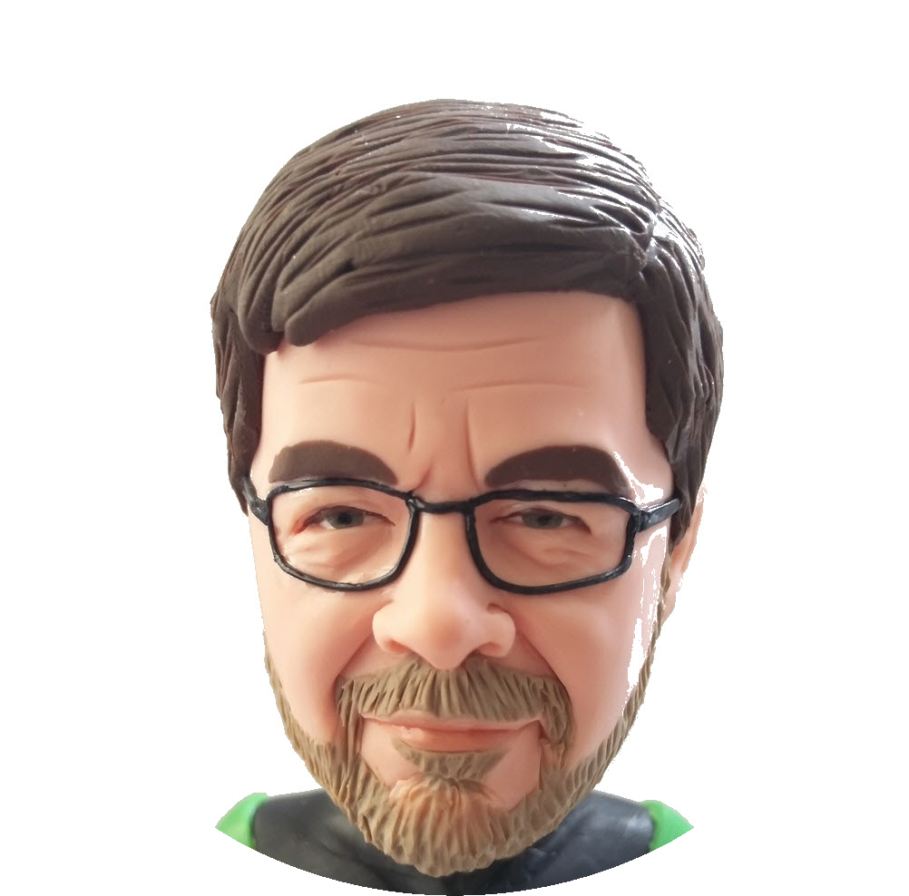
Contact
Luc Dekens
Twitter: @LucD22
Blog: https://lucd.info
VMTN PowerCLI Community

